Slide 1
SMART CITY REAL-TIME DATA-DRIVEN TRANSPORTATION SIMULATION

Slide 2
Agenda
Research Objective
Background
Model Architecture
Result and Discussion
Future Work

Slide 3
Understanding Research Objective and Motivation
What?
A hybrid traffic simulation model, consisting of a mix of preprogrammed and real-time data-driven intersections, is developed.
How ?
An optimized architecture is developed that enables
control of signals and vehicle volumes using real-time in-field detectors data, and
real-time processing of the simulation vehicle trajectories to generate travel-time, energy, and emissions performance indices

Slide 4
Understanding Research Objective and Motivation
Why?
To assesses feasibility aspects of using a real-time data-driven transportation simulation model to
evaluate and visualize network performance indices, and
provide dynamic operational feedback in a real world environment, in a big data context

Slide 5
Model Architecture Overview
Model performs three primary tasks:
injects real-time data into the simulation model,
runs the traffic simulation model, and
visualizes the performance metrics
Dynamic links are established between these three components to ensure simulation runs faster than real-time operations.

Slide 6
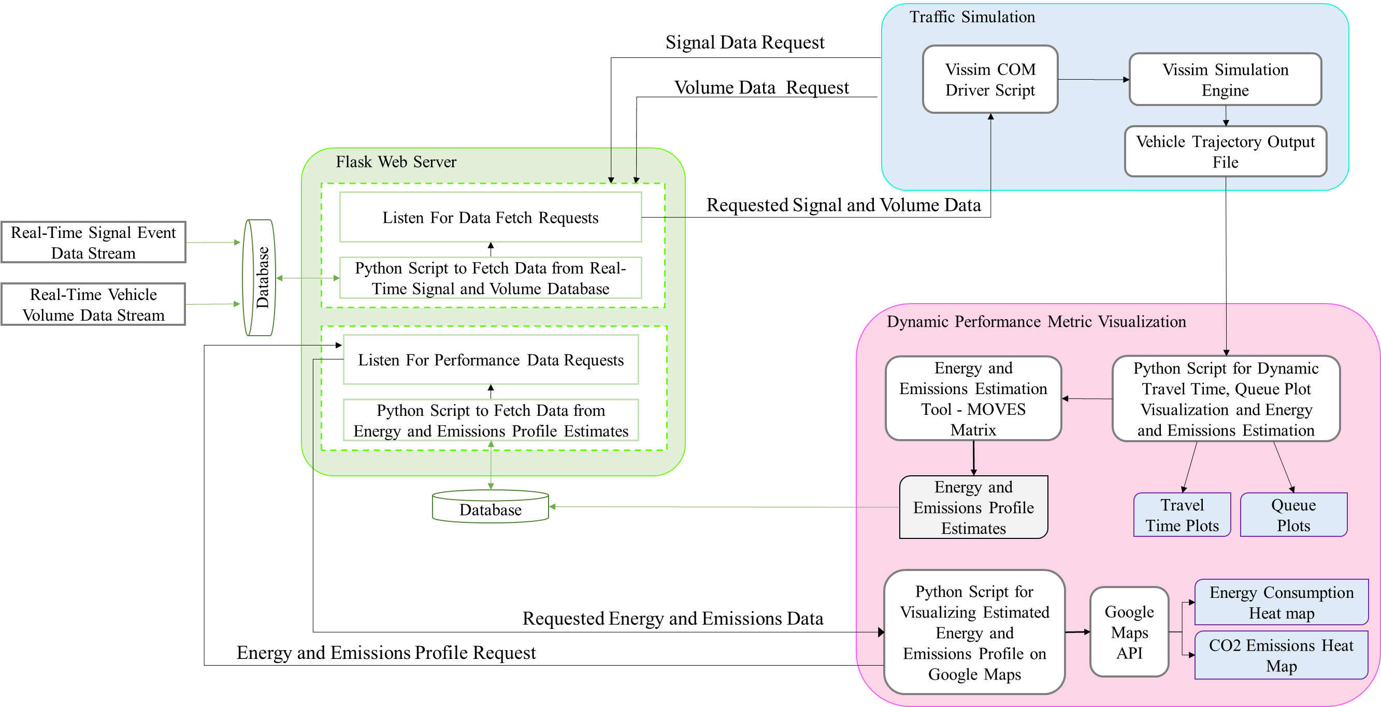
Model Architecture Overview

Slide 7
Model Architecture: Traffic Simulation Model
Model simulates 2.6 miles of the North Avenue NW corridor
North Ave corridor currently being upgraded to a connected corridor as part of the North Avenue Smart Corridor project led by the City of Atlanta
Model built using PTV’s Vissim version 9.00- 08
Simulation model contains seventeen signalized intersections

Slide 8
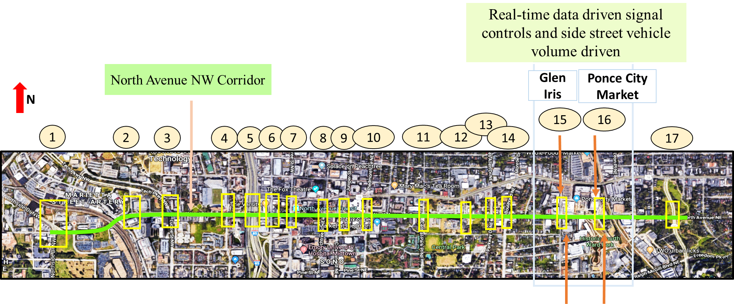
Model Architecture: Traffic Simulation Model (2)
At two consecutive intersections - Glen Iris Drive at North Avenue and Ponce City Market at North Avenue - signal controls and vehicle volumes are driven using real-time signal control events and vehicle volume data from field sensors
The remaining 15 intersections use the preset values in the calibrated model

Slide 9
Model Architecture: Traffic Simulation Model (3)
Primary inputs for the Vissim transportation model are
signal timing plans,
vehicle volume inputs and
turning movement percentage splits at the intersections
Signal update logic
Signal events data is polled out of the field signal controllers
contains a 10Hz series of timestamped eventIDs and the corresponding parameters
Volume update logic:

Slide 10
Result and Discussion (1)
The first set of results refer to the real-time outputs from the model during runtime.
The second set presents the results of the test of robustness of the simulation model in the presence of real-time inputs and the test of sensitivity of the model to these real-time inputs.

Slide 11
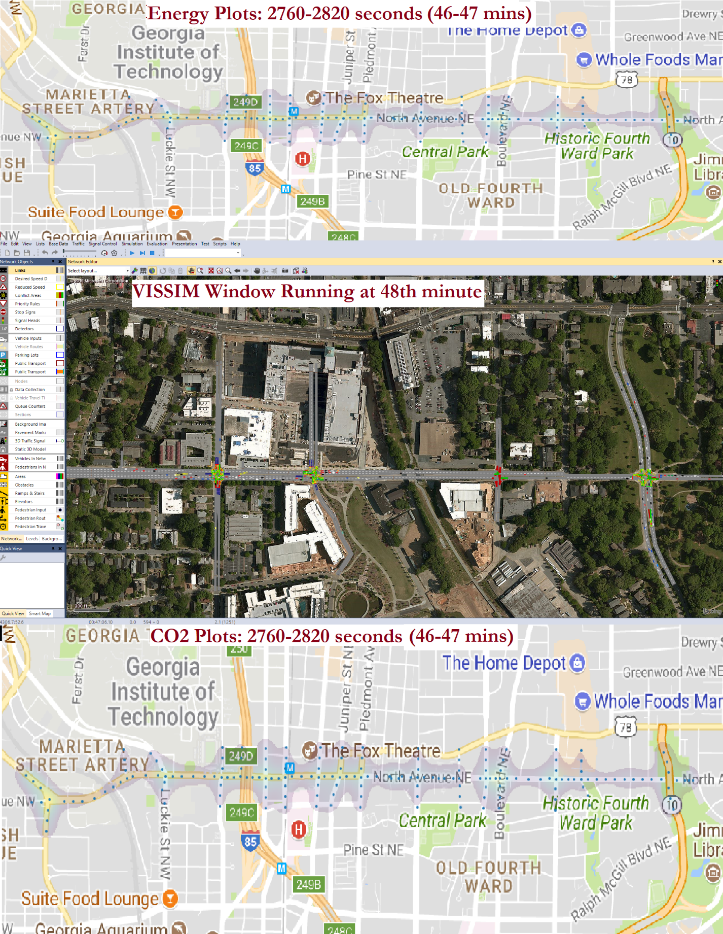
Result and Discussion: Real-time Performance Measures Computation
Queue lengths, energy and emissions were visualized in real-time.
Can be implemented in connected vehicle environment in smart corridors
This was tested on a 3 hour PM peak model run.

Slide 12
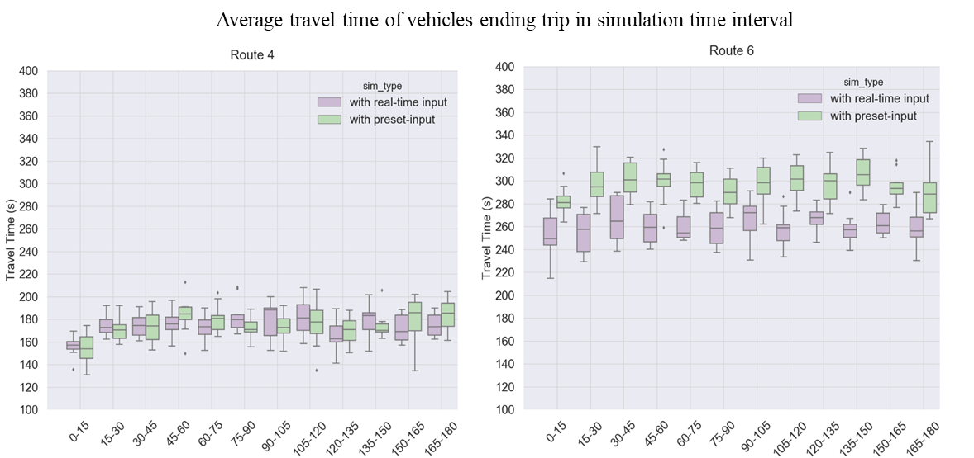
Result and Discussion: Model Sensitivity to Real-Time Input
Vehicle Travel Time
Travel times were compared for 10 random seeds of simulation
The travel times varied between two cases within plausible bounds.

Slide 13
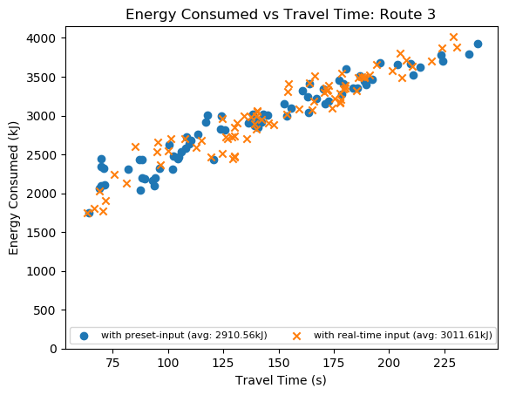
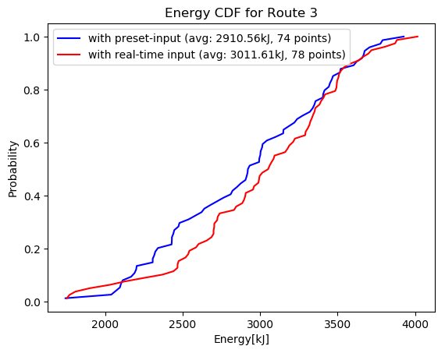
Result and Discussion: Model Sensitivity to Real-Time Input
Energy and Emissions
Energy and emissions estimated using MOVES matrix were compared.
Energy results generated from pre-set and real time inputs were comparable as shown in the scatterplots and CDF.
Emissions showed similar trend.

Slide 14
Conclusion
Real-time simulation models
Discussed feasibility aspents of real-time data-driven transportation simulation model
The process was validated by comparing then with results from simulation driven by preset input
The current arcchitecture was succesfully implemented at a near-real-time speed.

Slide 15
Future Research
Real-time simulation models
Remains to be tested on larger scale with more real-time data at higher number of intersections.
If wide area simulation is required, then the architecture will need to integrate a distributed simulation structure.

